Slide 1
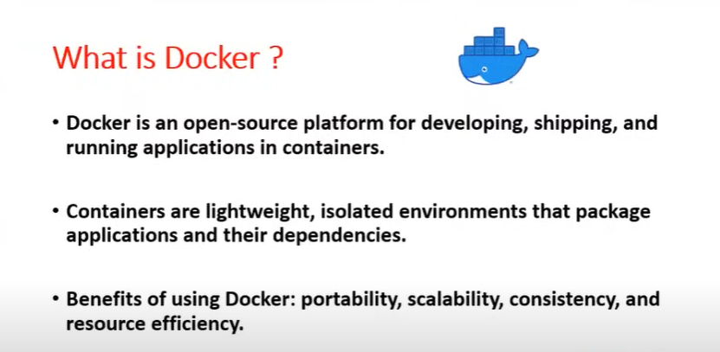
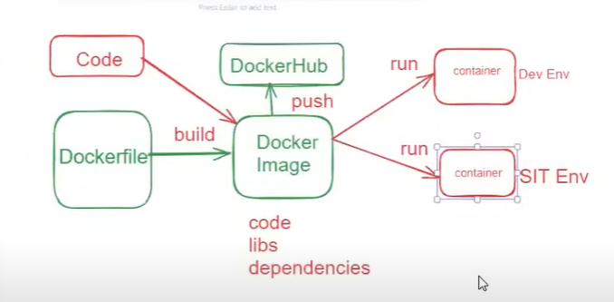
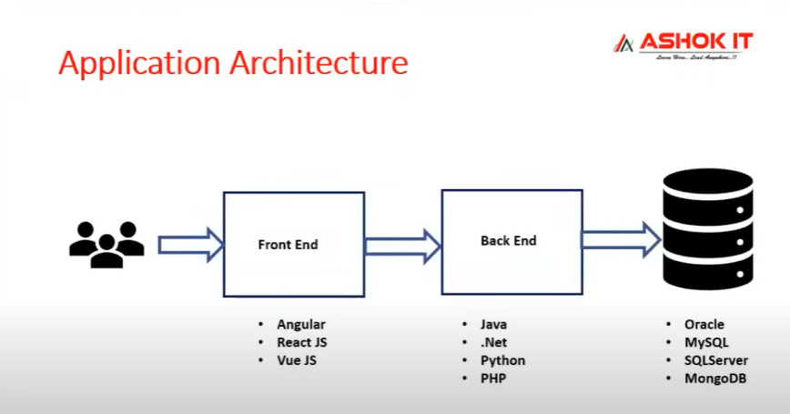
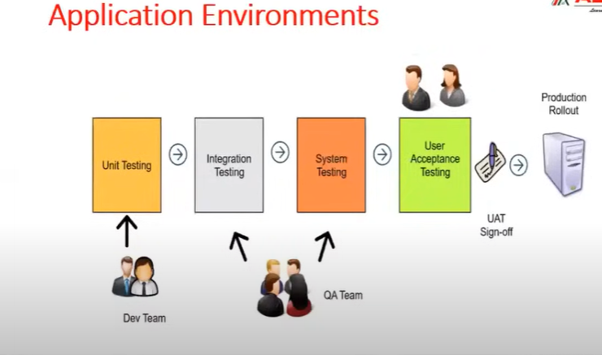

Slide 2
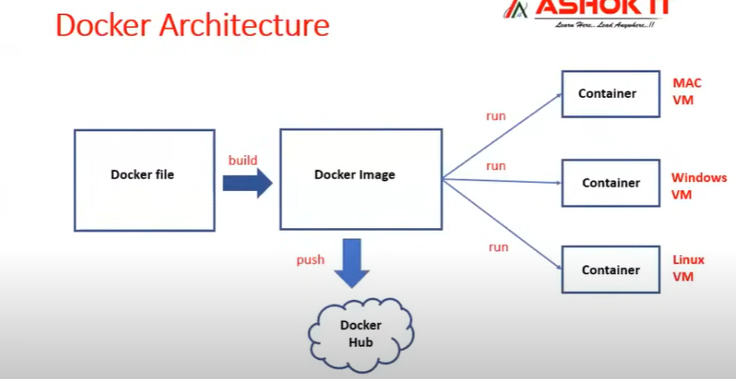
Docker => Docker is a containerization software
Docker is used to simplify our application deployment process
Docker will take care of required dependencies of application
Using docker we will run our application as a container
What is containerization ?
The process of packaging our application code and dependencies as a single unit and executing inside container
Called containerization
=> Container isa virtual machine ( Linux virtual machine)

